Slide 1


High-performance services with gRPC

Slide 2



About me!
Rachanee Saengkrajai (Apple)
Software Engineer Team Lead
~10 years of .NET experience
Microsoft and Azure certified
Personal website
Facebook
Medium

Slide 3
Topics
Why gRPC was invented?
API Timeline
What are REST problems?
What is gRPC?
How does it work?
gRPC vs REST
gRPC in .NET 5
Demo
What’s new in .NET 5
Performance improvement in .NET 5

Slide 4
Why gRPC was invented?
API Timeline
REST problems

Slide 5
API Timeline
1998 XML-RPC
2000 REST
2007 ODATA
2016 gRPC
1996 HTTP/1.0
1999 HTTP/1.1
2015 HTTP/2
1999 SOAP
2005 JSON-RPC
2015 GraphQL

Slide 6
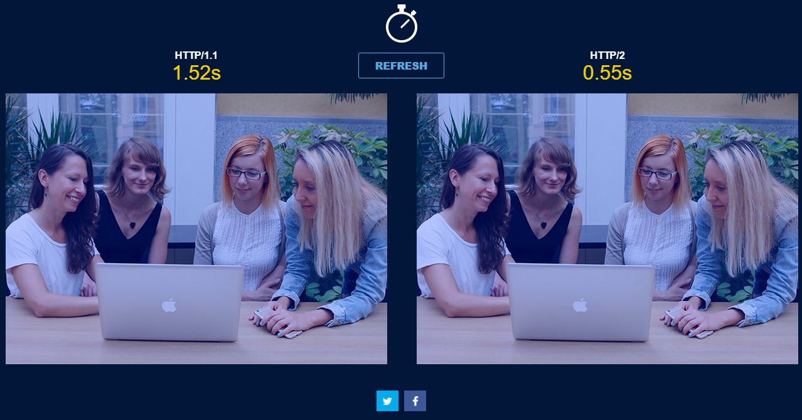
HTTP/2 is a game changer!
Multiplexed (solve the request pipelines blocking)
Single TCP Connection for parallelism
Binary instead of textual
Header compression
Streaming
Server push
http://www.http2demo.io

Slide 7



Can we use REST on HTTP/2?

Slide 8
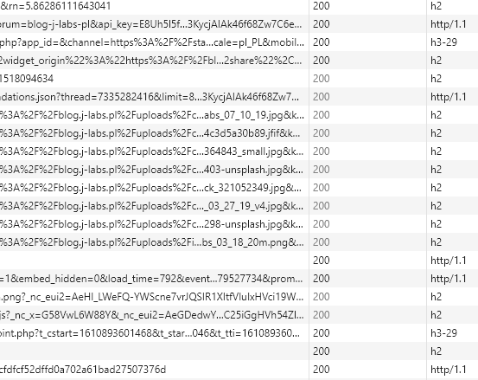
YES!

Slide 9
What are REST problems, then?
REST cannot make use of some HTTP/2 features.
Textual representation(JSON).
Implement streaming is complicated.
Bi-directional streaming is not possible at all.
Need to implement authentication, load balancing, tracing, health check etc.
No formal machine-readable API Contract.
So, it needs human or third-party library to create it
Imagine providing and maintenance 5+ client libraries.

Slide 10
What is gRPC?
How does it work?
gRPC vs REST

Slide 11

gRPC is a modern high-performance RPC framework
Remote Procedure Call framework is a set of tools that enable calling a piece of code in a remote process as if it were a local procedure call, for example SOAP, WCF, Thrift etc.
Initialised by Google
It is part of Cloud Native Computing Foundation (CNCF)

Slide 12
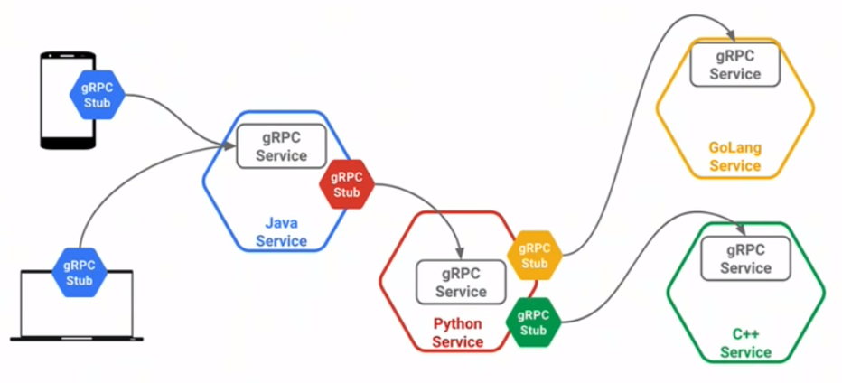
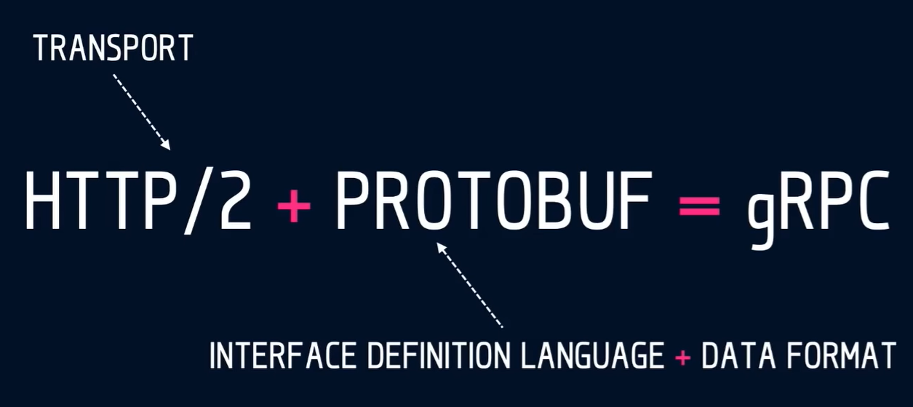
How does it work?
Proto Request
HTTP/2
Proto Response
https://youtu.be/hNFM2pDGwKI

Slide 13
gRPC vs REST
REST | gRPC
Cannot maximize using HTTP/2 e.g., compression, streaming etc. | Makes better use of HTTP/2 e.g., selective message compression, first class load balancing, heavily optimized.
Text based (JSON) messages which is human readable (easy for debugging), use more bandwidth and slower. | Binary-based messages which is machine-readable (hard for debugging), save bandwidth about 3x times, faster.
Need to implement authentication, load balancing, tracing, and health checking. | Pluggable authentication, tracing, load balancing, and health checking.
Client libraries must be generated by human or third-party libraries, more supported languages more resource needed. | Client and server code can be auto generated in 12+ languages C#, Java, Python, Go, Ruby, Node.js, Kotlin etc.
Fully support JavaScript on browsers as client. | Not officially support JavaScript on browsers as client yet but in progress.
Loose coupling between clients/server. So, it does not need to setup a client. You just make a call to a server address. | Standardizes on Protobuf. Need a generated client code from .photo file and gRPC stub on client.

Slide 14
gRPC in .NET 5
Demo
What’s new in .NET 5
Performance improvement in .NET 5

Slide 15
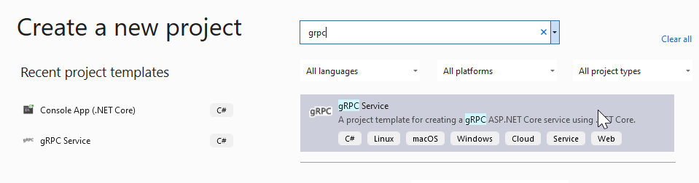

Create a gRPC project

Slide 16
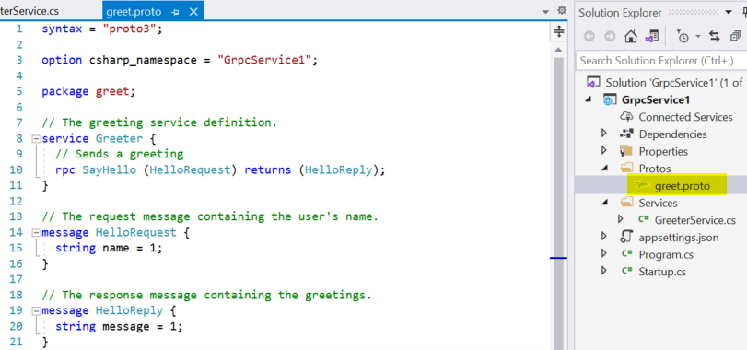
.photo file

Slide 17
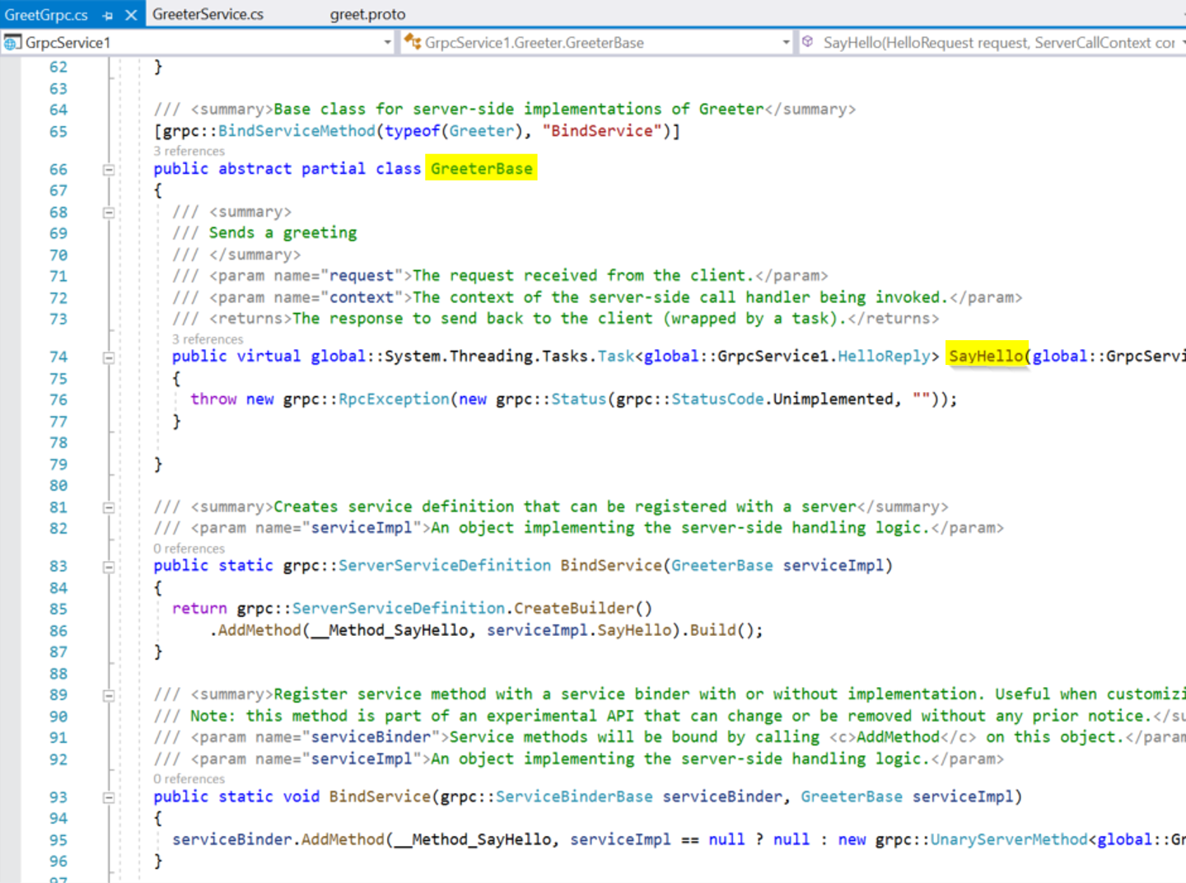
Auto-generated server code

Slide 18
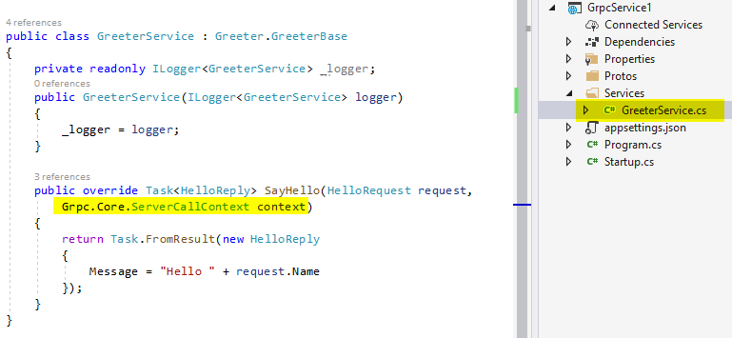
Server code

Slide 19
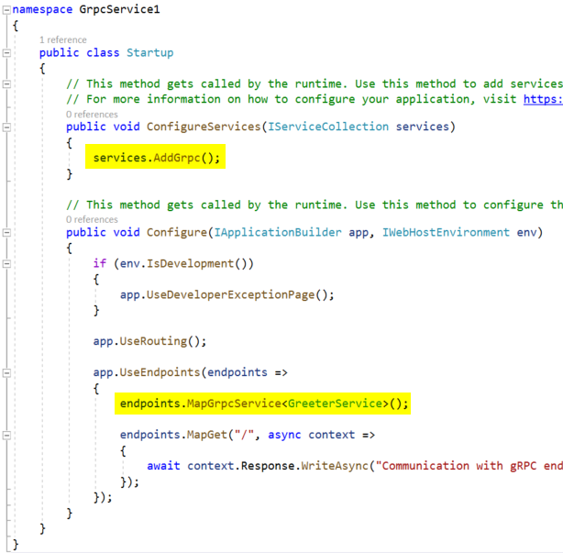
The Startup.cs file

Slide 20
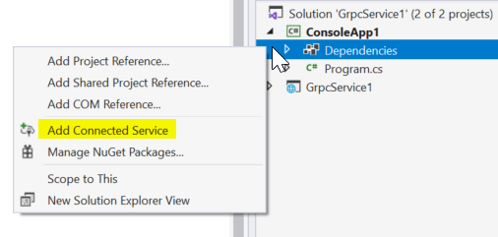
Add connected service to client

Slide 21
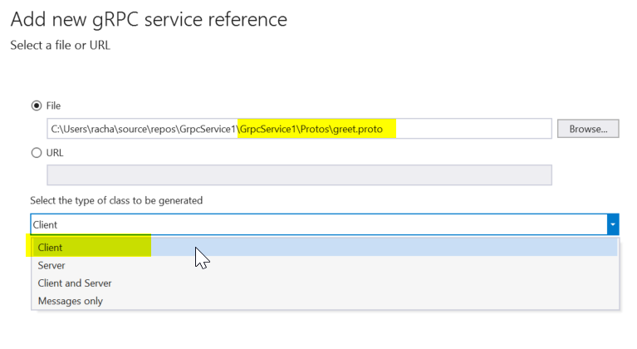
Browse the .photo file in the server project and select to generate client code.

Slide 22
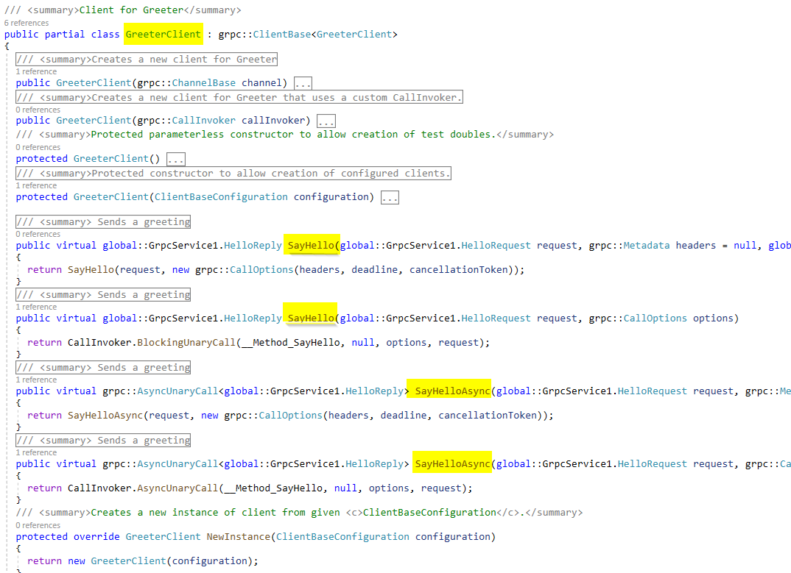
Auto-generated client code

Slide 23
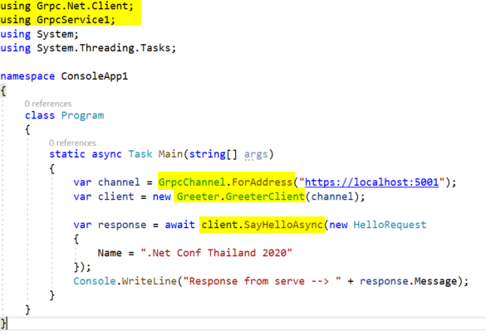
Client code

Slide 24
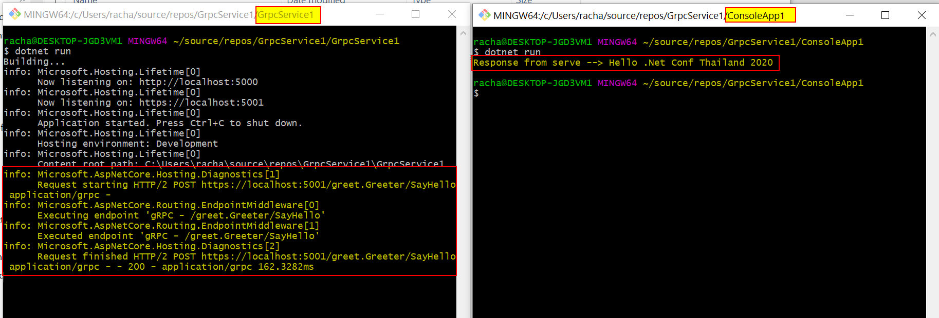
Test calling from client to server

Slide 25
What’s new in .NET 5
gRPC-Web browser support
gRPC-Web server middleware
gRPC-Web Blazor client
New gRPC hosts on Windows (alternative to Kestrel)
IIS
HTTP.sys
Inter-process communication with Unix Domain Socket (UDS) and named pipes besides TCP
Aggressive trimming unused assemblies when publish app

Slide 26
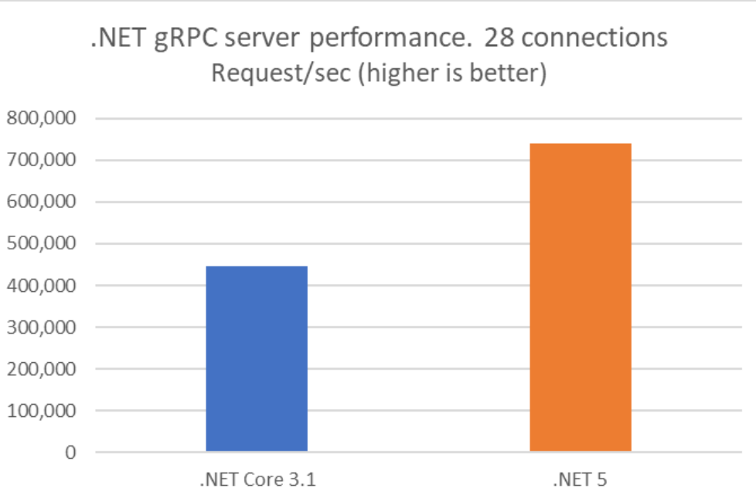
Performance improvement in .NET 5
Reduced latency, improved concurrency.
HTTP/2 server allocation reduced by 92% compare to 3.1.
Kestrel support response header compression.
Protobuf serializer uses Span<T>, this allow skipping temporary buffer allocation when serialize/deserialize messages.
Server req/sec increased by 65%
Client req/sec increased by 220%

Slide 27
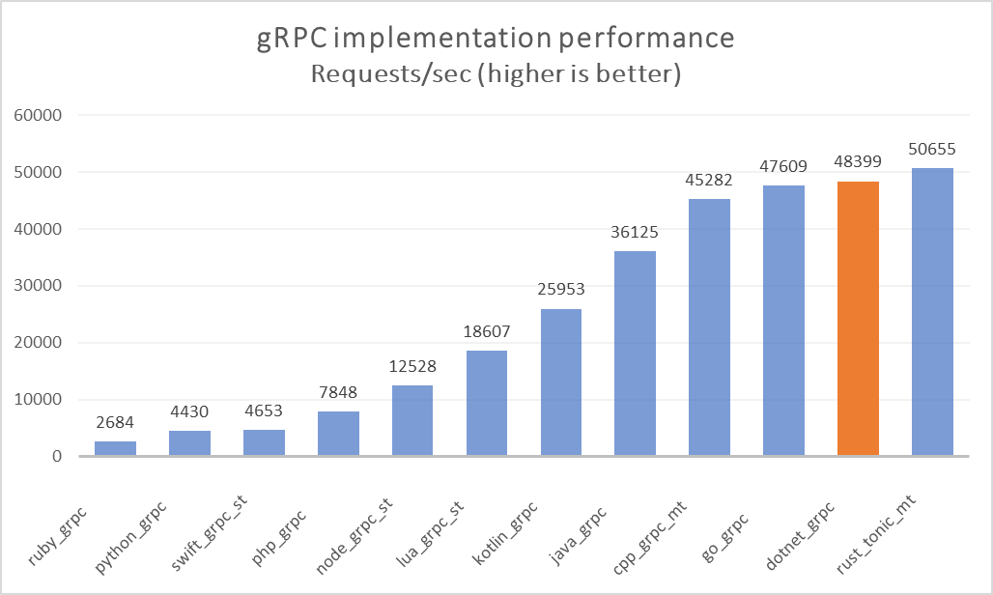
Benchmark for gRPC in .NET 5
https://devblogs.microsoft.com/aspnet/grpc-performance-improvements-in-net-5/

Slide 28
Summary

Slide 29
Summary
HTTP/2 is the next generation for HTTP/1 and gRPC is the next generation for REST.
gRPC in .NET is blessing fast.
Use cases
Internal APIs: try it on new services then gradually migrate existing services.
Public APIs: may wait until gRPC get widely used so that your clients can keep up with.
GraphQL still being a good choice for some cases like queryable and aggregatable APIs.

Slide 30
Resources

Slide 31
Resources
gRPC on .NET
.NET Examples
Who’s is using gRPC and why?
gRPC conf 2020

Slide 32

gRPC is the future…

Slide 33

Thanks for joining!

